Slide 1


31 October 2026
Participant Brief Deck

Slide 2
Tooling Setup
Wifi Access
Codex Credits (USD 100) and API Credits (USD 100)
Guest Wi-Fi will be provided at the venue. Wi-Fi login instructions will be shared on the event day.
Each team member will be given USD 100 in OpenAI API credits and Codex credits for hackathon usage. Look out for a setup email from OpenAI 1 day prior to the event with instructions to activate your credits before the hackathon.
Note:
Link/coupon code is unique to you and can only be redeemed once. Do not share it.
Please install the Codex app prior to the event.
Access and credits are provided for participants attending the full hackathon on 31 October, and may be revoked if a participant or team is no longer attending or leaving early.

Slide 3
Agenda
8:30 AM |  | Doors Open & Registration
9:20 AM |  | Opening
10:00 AM |  | Hacking Starts
12:30 PM |  | Working Lunch
2:30 PM |  | Tea Break & Work-in-Progress submission
5:00 PM |  | Code Submission Deadline
5:00 PM - 7:15 PM |  | Dinner + First Round Judging
7:15 PM |  | Final Round (Top 5)
8:30 PM |  | Prize Presentations
9:00 PM |  | End of Event

Slide 4
Hackathon Rules
All work must be done on-site.
Building on existing project
Allowed only if:
You may either:
New extensions are significant and substantial. Only work built during the hackathon will be judged.
01
02
Built in a new public repository.
Start from
scratch
Build on an existing
personal or
open-source project
Link to the existing repository / repositories must be provided in your README and submission form.
State clearly what was built during the hackathon in your README and submission form.
Any infringement of these rules may result in disqualification.

Slide 5



Build Directions
Autonomous &
Adaptive AI
01
AI-Native Products
& Operations
02
Deep Domain AI
03
Agents that operate reliably without constant human oversight
Products, services, and operations fundamentally redesigned with AI - or something that simply couldn't exist before
AI that reflects how expert work is actually done - not a simplified version
What we're looking for
What we're looking for
What we're looking for
Is this an agent you can trust to run autonomously - and does it get better the more it runs?
What can users or businesses now do that wasn't realistically possible before?
Would a domain expert trust this to do their job?
Please note that the hackathon idea and build directions on d-day should align with the ones in your initial registration.

Slide 6
Judging Criteria
01
02
03
Problem & Solution Fit
Build Quality
Insight & Originality
Is the problem real?
Is the solution the right answer to it?
Does it work and hold up under use?
We judge the product - not the pitch.
Is the approach genuinely novel, or just common industry practice?
04
05
06
Real-World Value
Alignment with Build Direction
Use of Codex
Based on the working demo - who benefits, and how significantly?
Does the build meaningfully reflect at least one build direction?
How deeply was Codex leveraged to build this product?

Slide 7
Presentation Format
APPLIES TO BOTH ROUNDS
6 min Demo / Pitch
2 min Q&A
Cover your problem, solution, and use of Codex. Judges will score against the criteria shared - grounded in what you built and can demonstrate.

Slide 8
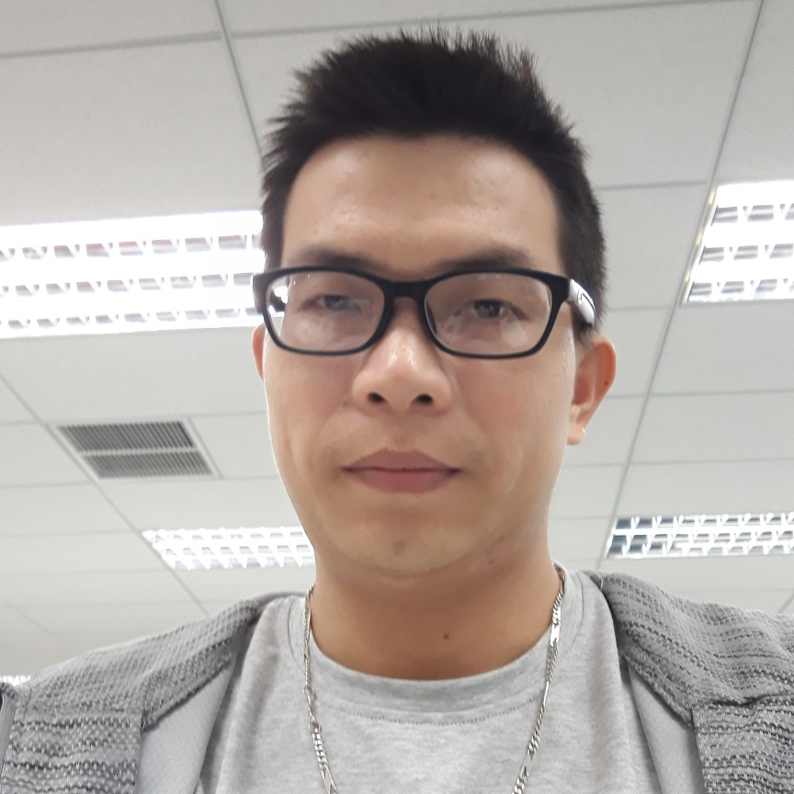

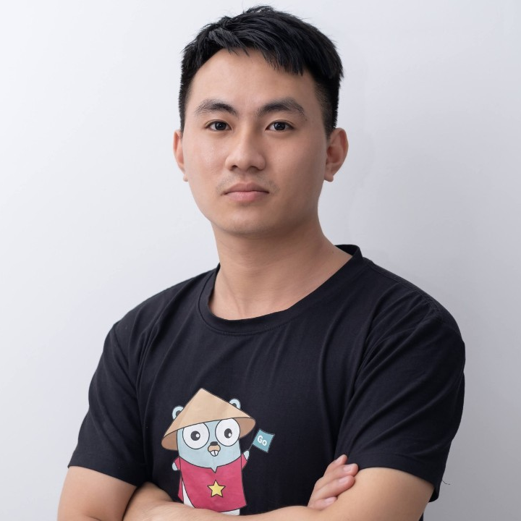
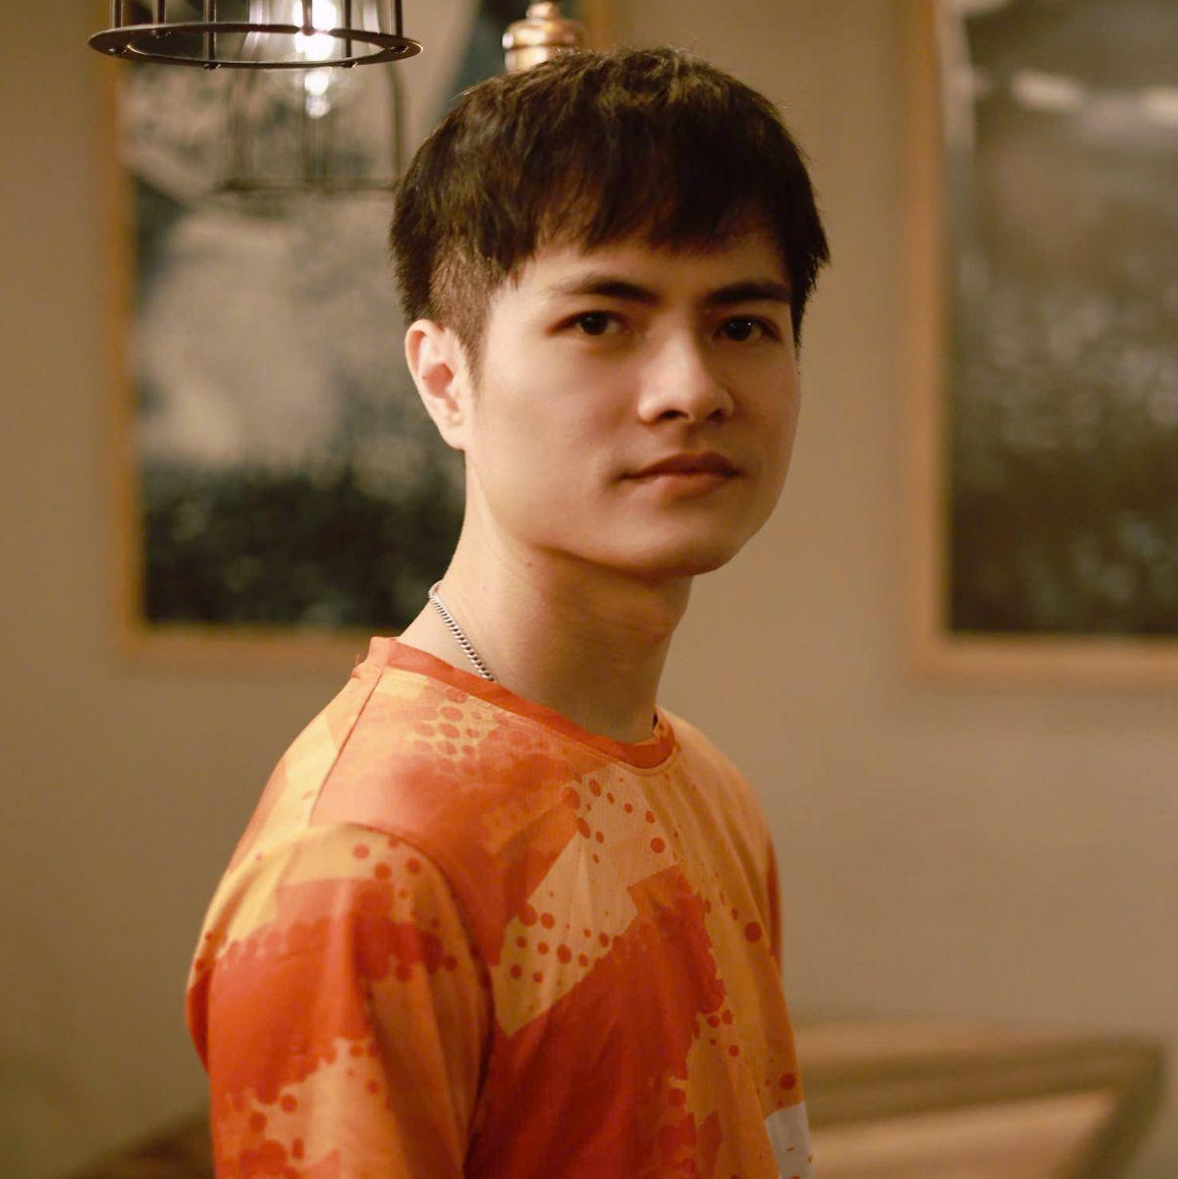
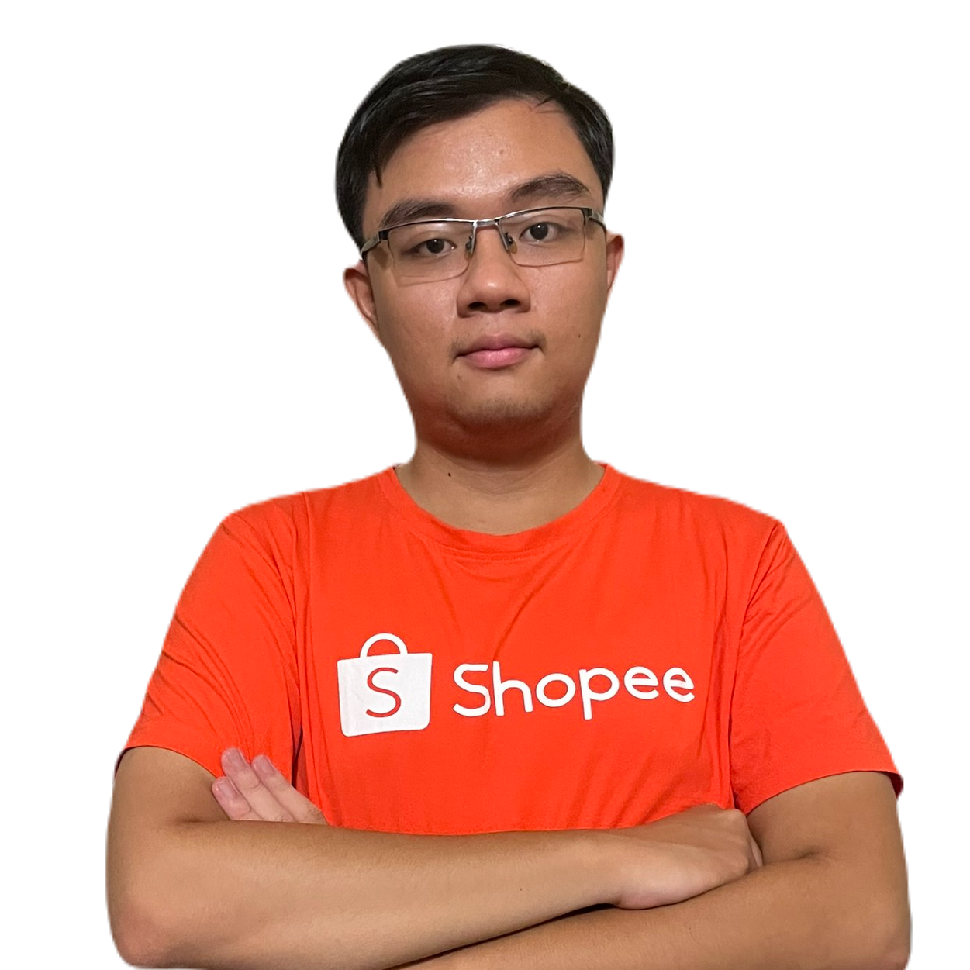
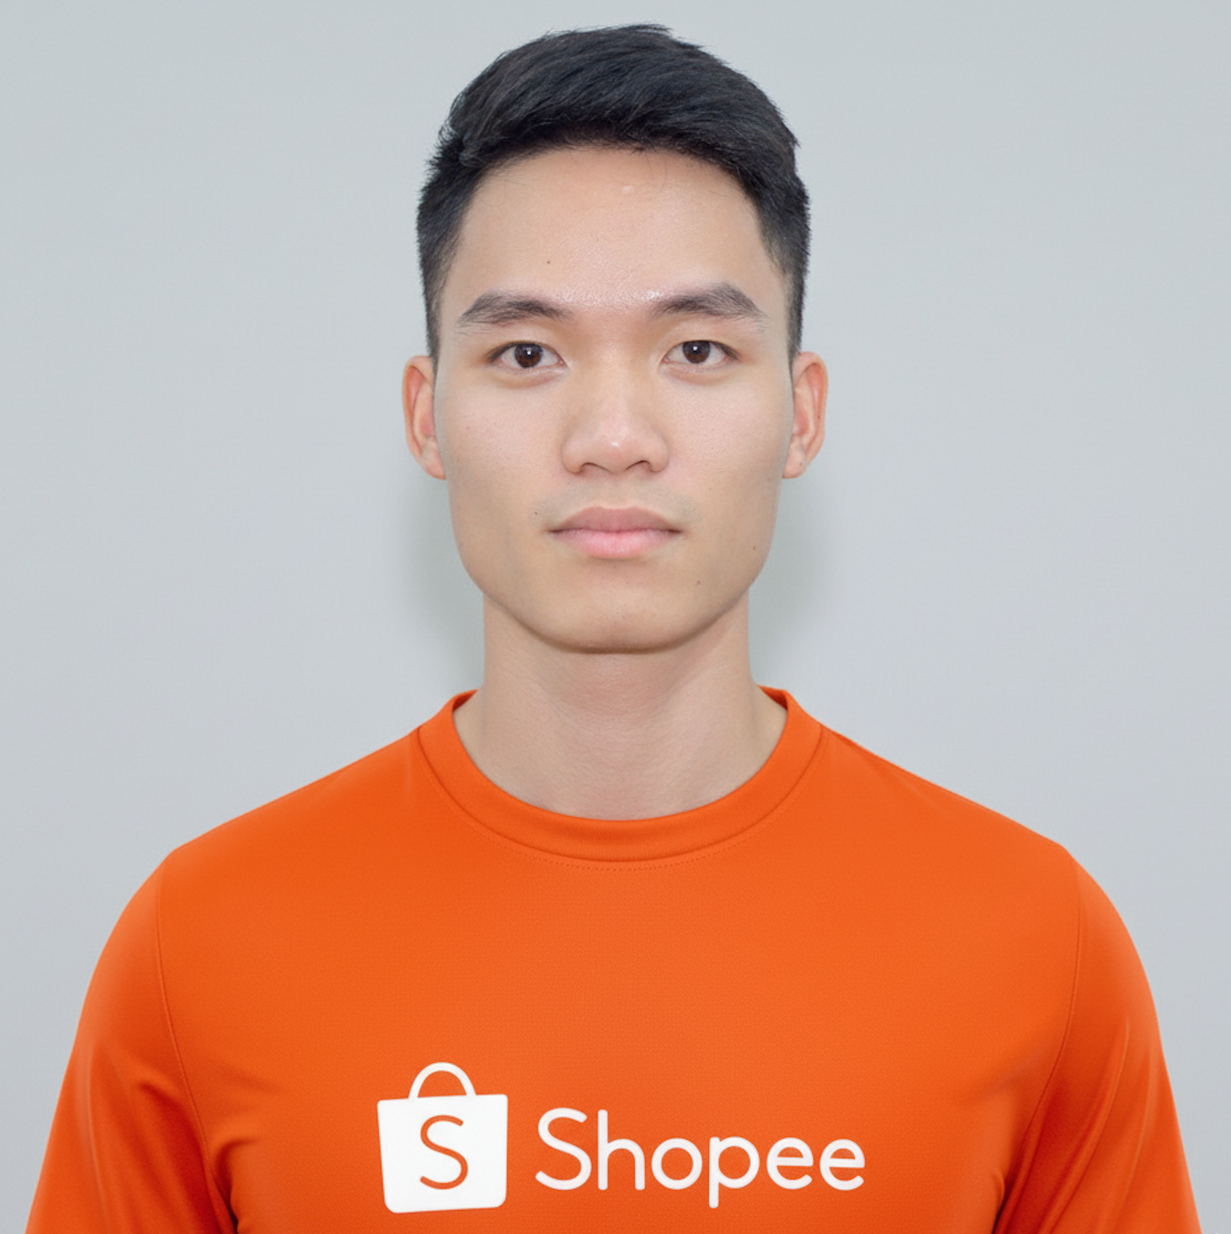
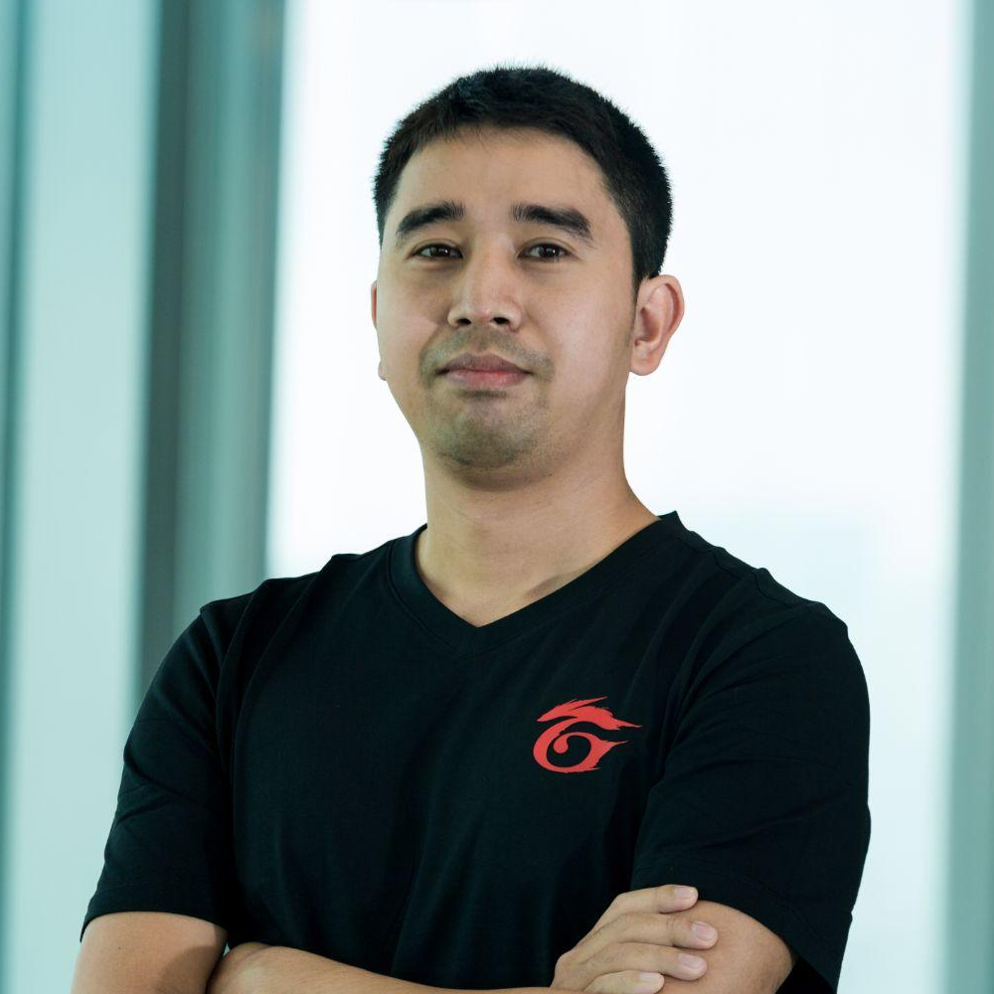
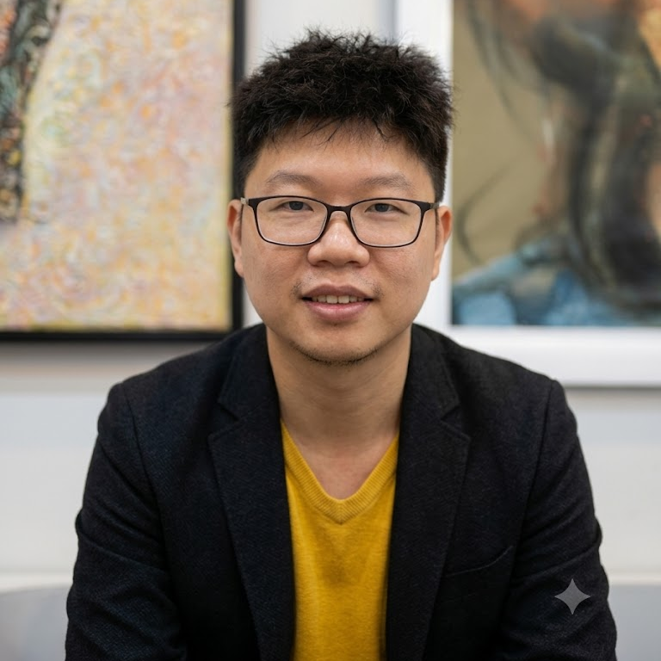
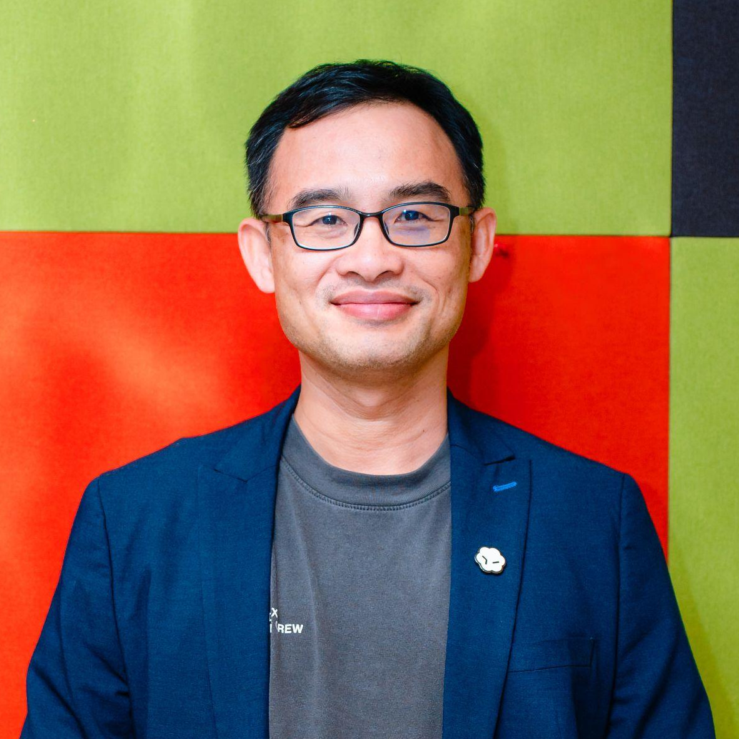
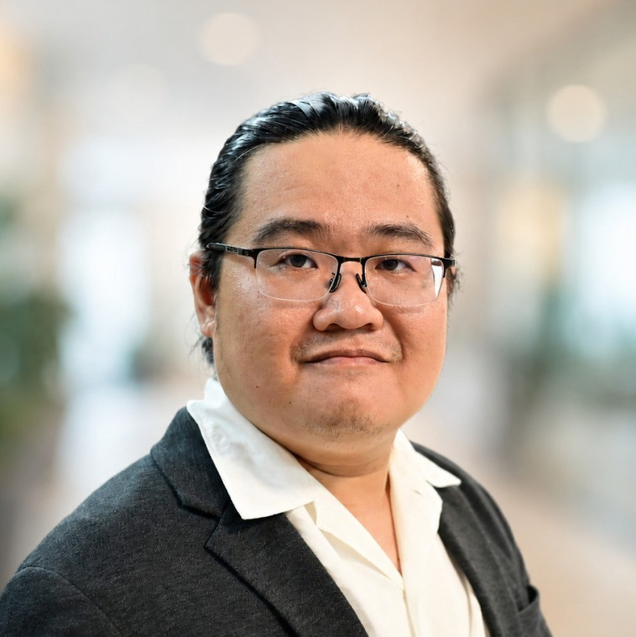
Round One Judges
Nguyen Thanh De
Doan Ngoc Bao
Van Xuan Ty
Nguyen Van Thai
Tran Hoang Viet
Shopee Vietnam
Shopee Vietnam
Shopee Vietnam
Shopee Vietnam
Shopee Vietnam
Le Quoc Khanh
Tran Trung Kien
Nguyen Minh Son
Le Thanh Son
An Nguyen
Shopee Vietnam
Garena Vietnam
Garena Vietnam
Codex Ambassador
Codex Ambassador

Slide 9
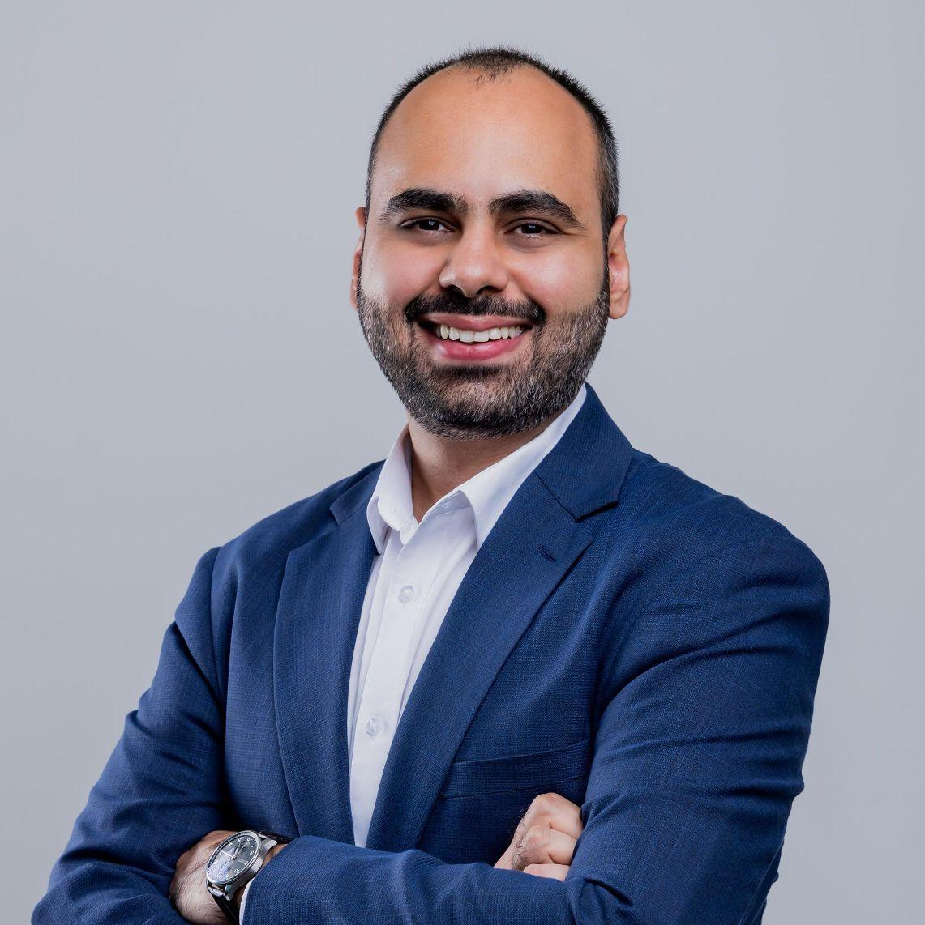
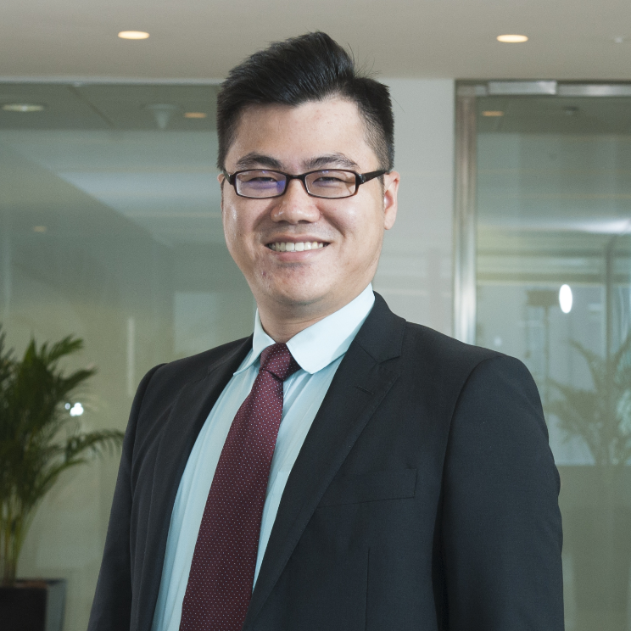
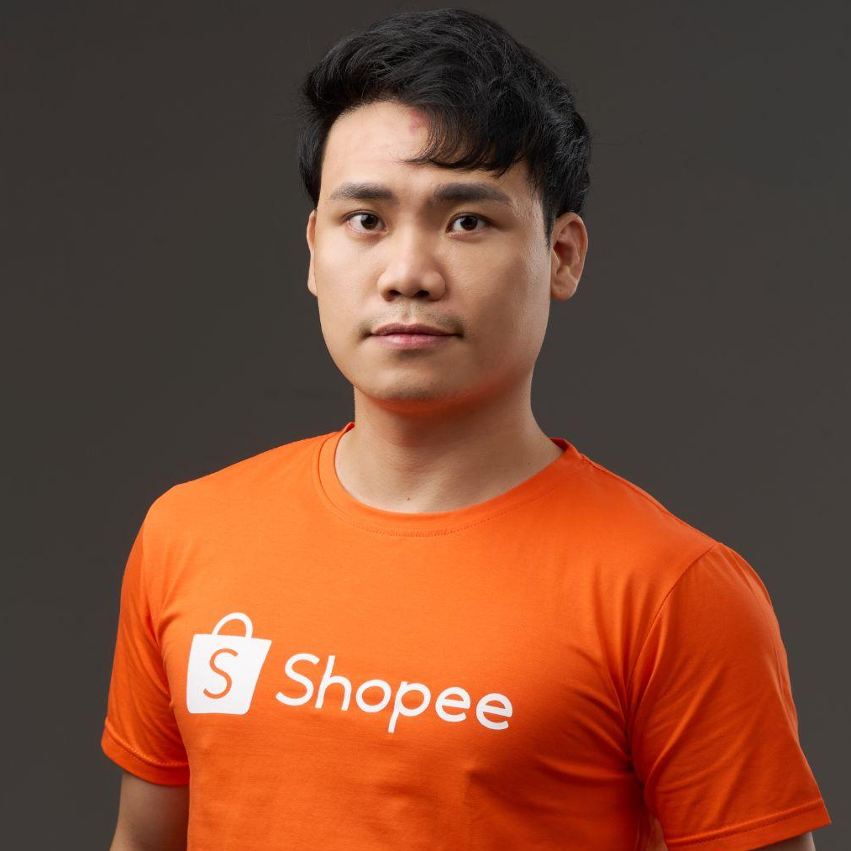
Final Round Judges
Sidharth Sharma
APAC GTM Director
OpenAI
Lee Chon Cheng
Director of COO Office
Sea Limited
Kyle Tran
Head of Product
Shopee VN

Slide 10
What to Submit
Each team to make one mid-time submission by 3:30 PM and one final submission by 5:00 PM via Google Form. Late submissions will be disqualified.
01
02
03
04
GitHub Repo
Project Write Up (PDF)
Demo Link
Declarations
New public repository created for this hackathon
Written summary of the problem, solution, build direction it aligns with, and how Codex was utilised.
Live demo or prototype link
State any existing OSS / personal project used, and what was built exclusively within this hackathon.

Slide 11
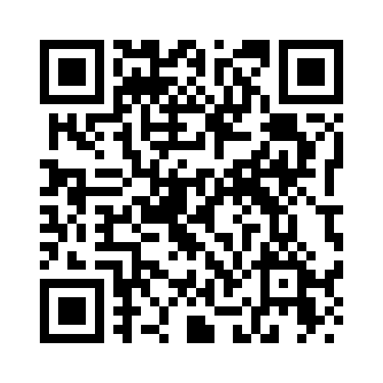
Work-in-Progress submission
https://forms.gle/qLFr4uqFfe21C5eL8

Slide 12
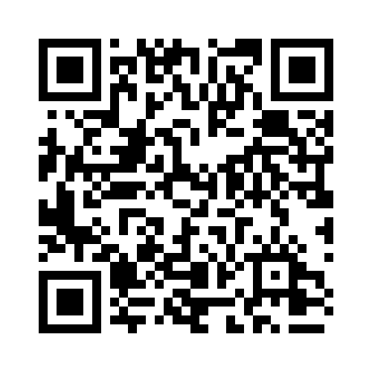
Final submission
https://forms.gle/vadUz9QxX6VdJTnu6

Slide 13
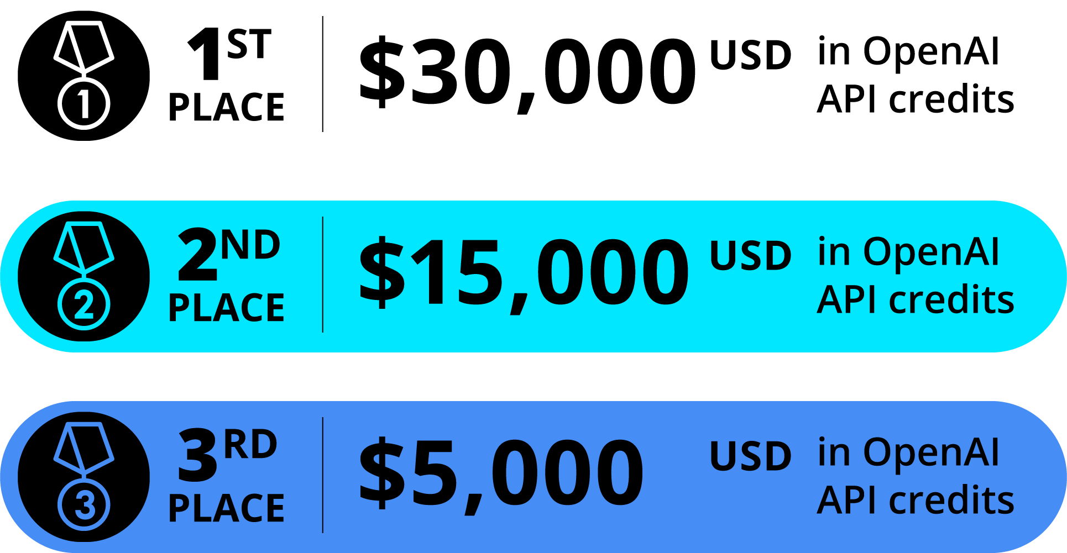
Prizes

Slide 14
Notes
01
02
03
Outfit
Arriving at the building
Attendance
Please wear polite outfits.
No shorts, no flip flops.
Please refer to this instruction on parking lot and how to access the building.
All team members must be present physically for the full day. Partial attendance or teams with fewer than 3 members will result in disqualification.
04
05
Check-in time
What to bring
Check-in opens from 8:30am to 9:15am. Teams that have not fully checked in by then will be disqualified.
Each member must bring their ID Card (or passport and valid visa for expats), as well as their own laptop and charger.

Slide 15
Share the Moment
Tag us at Sea and OpenAI, using #SeaxOpenAIHackathon2026!
🛠
👥
🔥
What will you build?
Who's on your team?
Why does this matter?
Share a sneak peek of the problem you'll solve.
Tag your teammates. Shout them out.
Real-world impact of what you'll solve.

Slide 16

See you there!

